Slide 1

Global Emissions
& Electric Vehicles

Slide 2
GREEN WAVE TEAM
RUCHITA
MICHAEL
TARINI
AVNEESH
KOBE PHO
Job Title
Job Title
Job Title
Job Title
Job Title
.

Slide 3

Contents:
About GHG emissions
Data Collection and Description
Data Preprocessing
Machine learning Design

Slide 4

CO2 is the major contributor to climate change.
Reducing carbon emissions is of extreme importance.
In order to actually get there, it would be necessary to reduce the greenhouse emissions to zero and then fix the past damage by drawing down on past emissions.

Slide 5

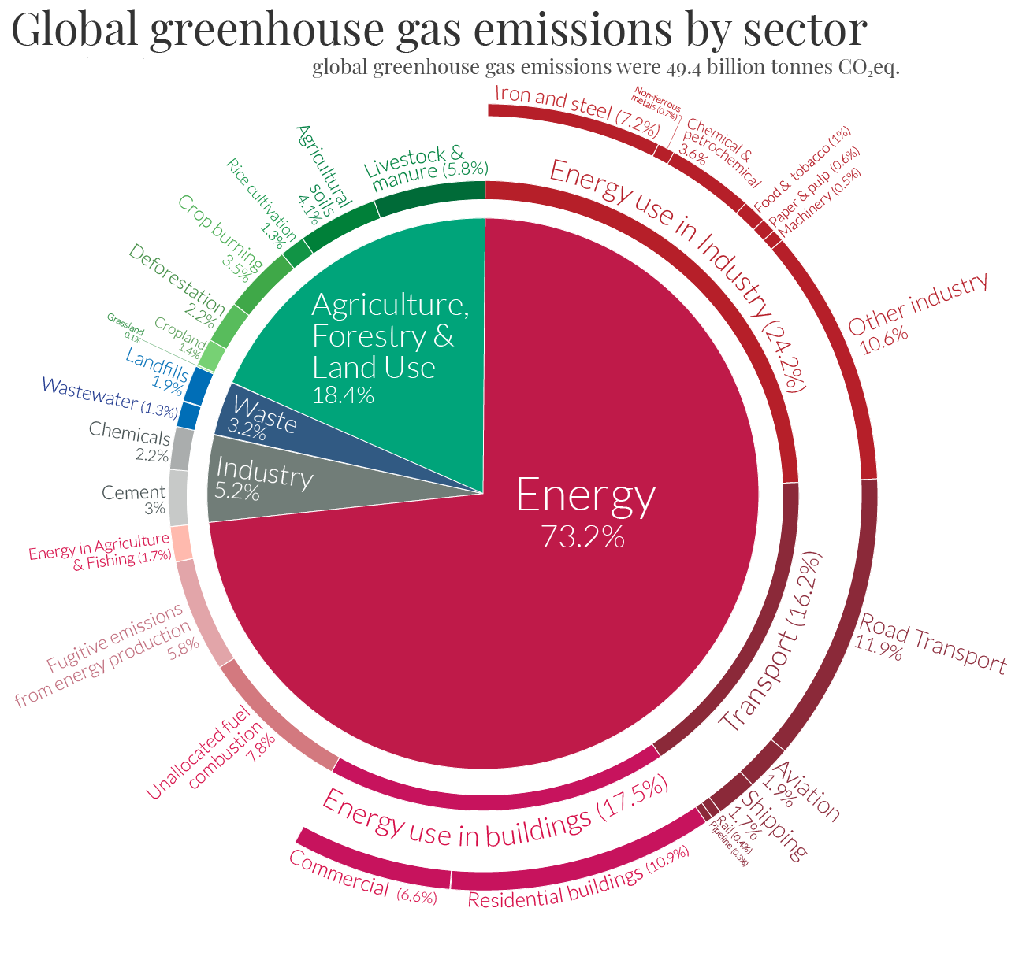
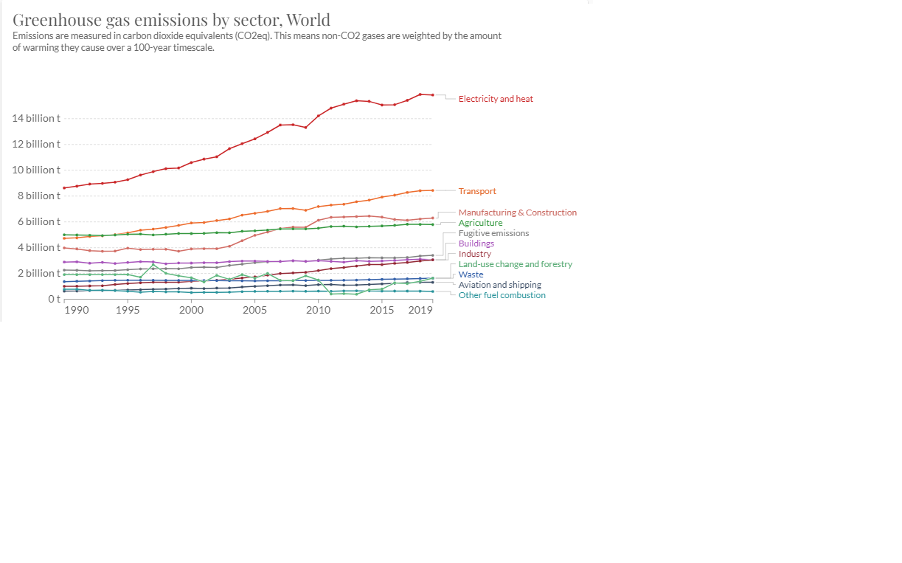
Overall Picture for GHG emissions
Project focus
CO2
Image source: ourworlddata.org

Slide 6
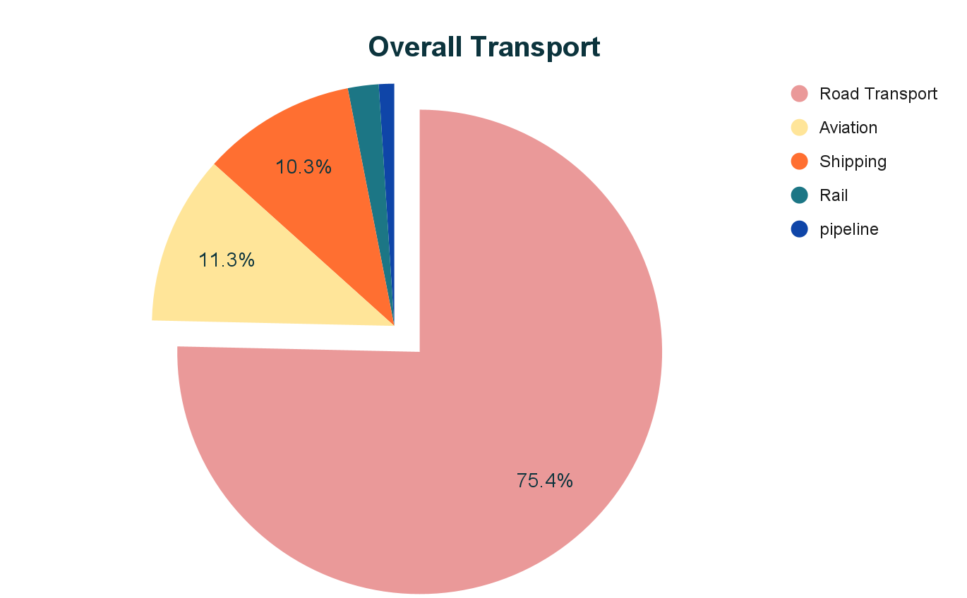


Around the world, huge percentage of Greenhouse gases come from cars. For each gallon of gas a car burns, it releases about 19 pounds of carbon dioxide comes right out of the tailpipe emissions.

Slide 7
Data Collection/Sources
Data Description/Preparation
Data Source:
https://ourworldindata.org/
https://www.epa.gov/ghgemissions/sources-greenhouse-gas-emissions
https://www.iea.org/articles/global-ev-data-explorer
Overall GHG emissions by sector.
Market demand of all vehicles types (Diesel, Electric, Hybrid, etc.)
Merged multiple datasets based on country and year as join keys.

Slide 8
Data Cleaning/Wrangling
Dropped empty values(200 Nan values).
Data type corrections(object to int).
Matched mapping of country names.

Slide 9
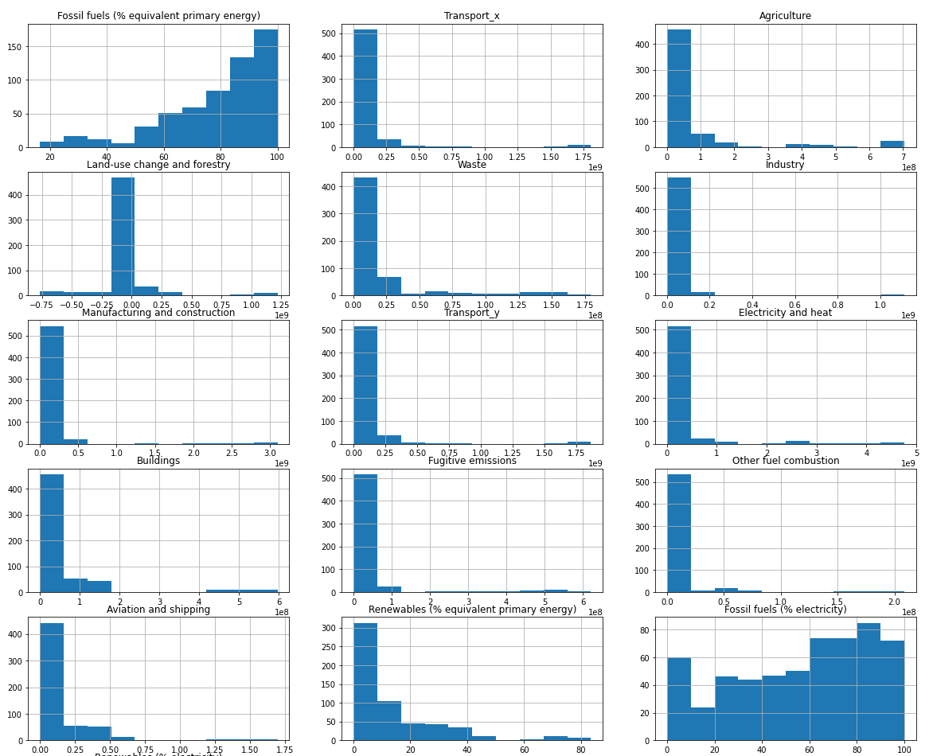
Univariate Analysis
Used univariate analysis to detect and remove outliers and applied log transformation to skewed features.

Slide 10
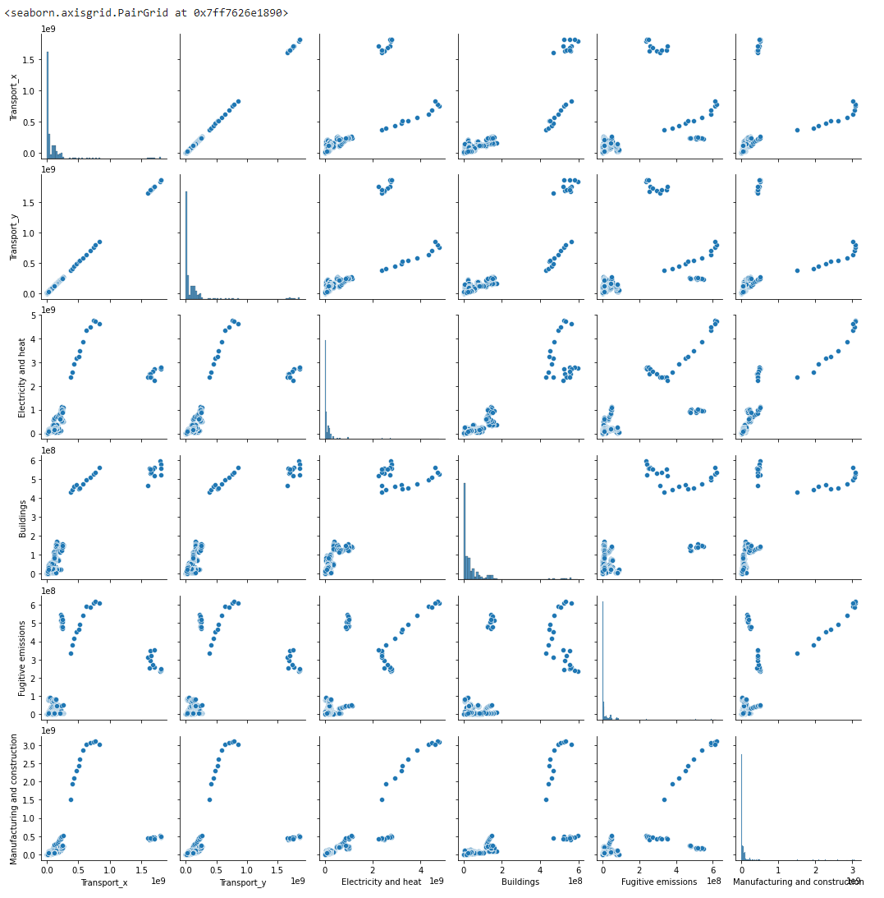
Multivariate Analysis
Used multivariate analysis to detect feature significance and correlation across features.
Transport_x is only CO2 emissions while Transport_y is overall GHG emissions including CO2. This is evident from the scatter plots.
We can clearly see correlations between various sectors that emit greenhouse gases.

Slide 11
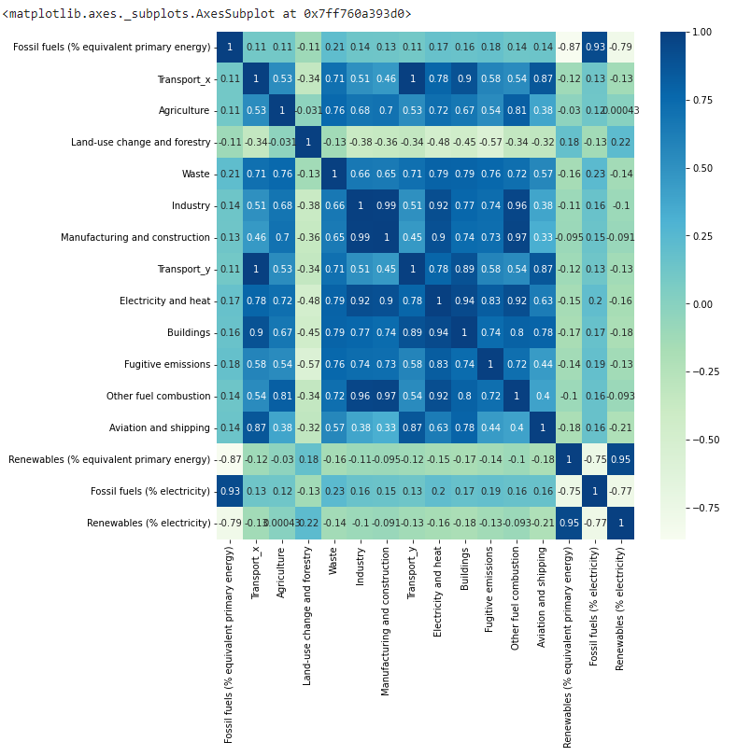
Correlation Matrix

Slide 12


Machine Learning Design
Hypothesis: EV vehicles lead to reduction in overall Greenhouse gases.
Problem Statement: Create a model that predicts how much CO2-eq by volume is offset by introducing EVs in a market (country+year).
X: ghg emissions by sector and energy production by fuel types
Y: CO2 offset due to EV
Target Variable(Y):

Slide 13
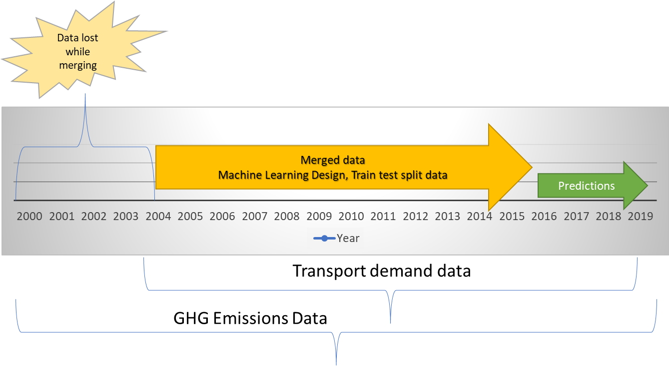
Machine Learning Design
80% of the data in the training set, 10% in the validation set, and 10% in the test set

Slide 14


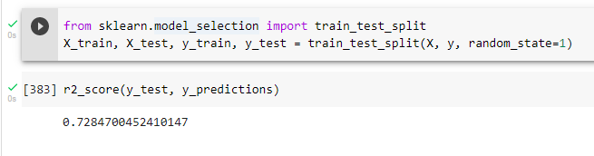
Linear Regression Model Performance
Train-Test-Validation Splits
Dropping Electric bike data improved performance by 10%
Train-Test-Validation split improved performance by further 12%

Slide 15
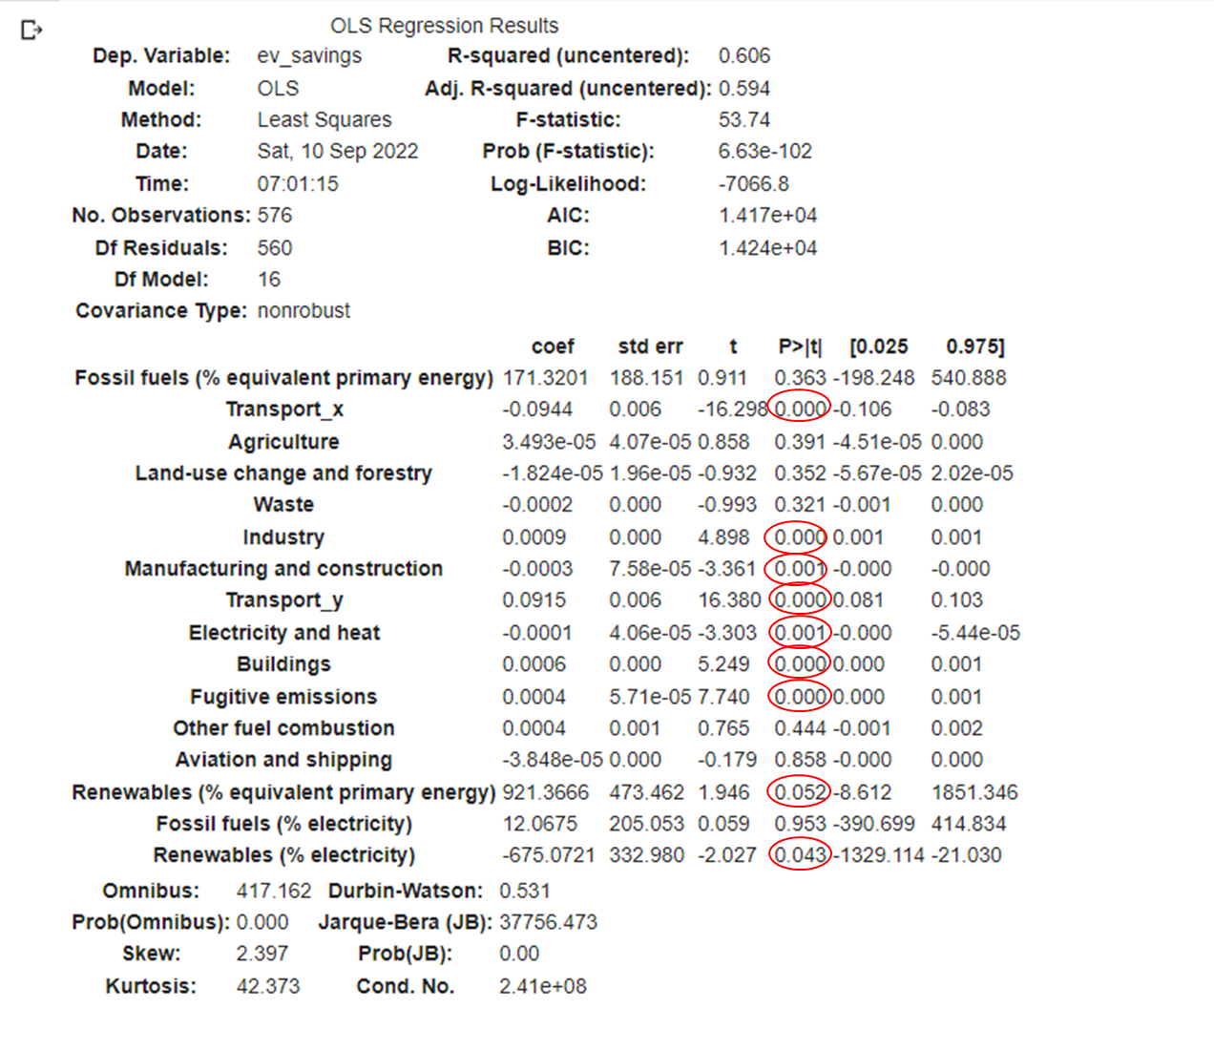
Hypothesis Testing
With a P-value threshold of 5 percent, we can see that the expected sectors are significant while predicting CO2 offset from EVs(P-value less than 5%).
Transport
Industry
Manufacturing
Electricity and Heat
Buildings
Fugitive Emissions
We can also see that Primary and Secondary Energy production from Renewables have some significance(P-value close to 5%)

Slide 16
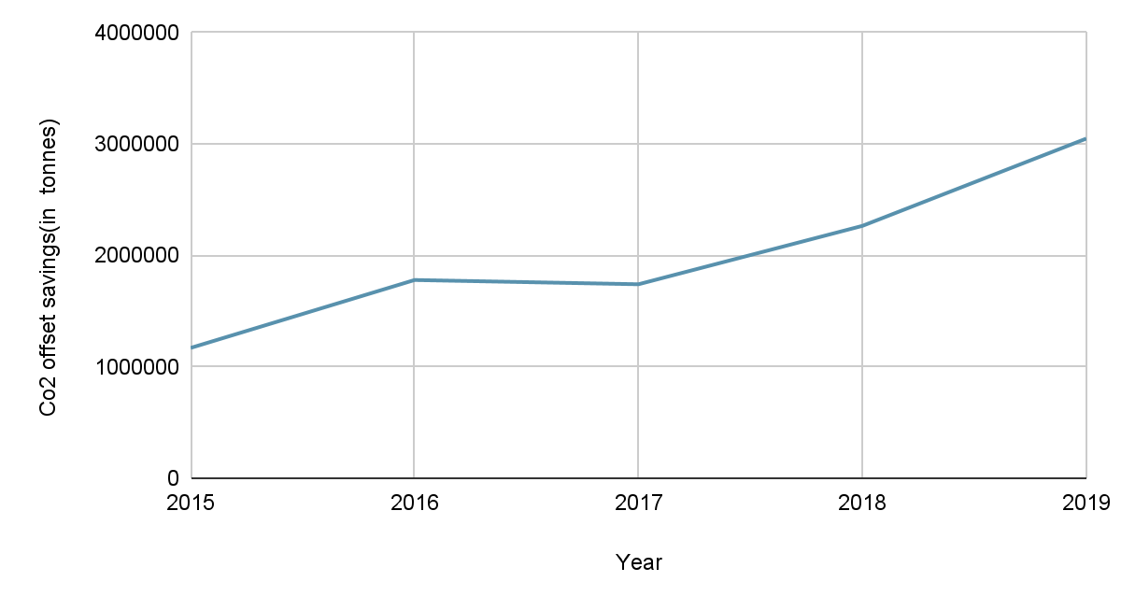
Forecasting/Predictions
Although we do not have the y-values of the target variable(co2_offset/ev_savings) from 2015-19, we do have the input features(X values).
We used the model to generate predictions and see that the CO2 offset due to EVs is predicted to be increasing year over year, as expected.

